Slide 1
GeoDesign
Definition Process Technology

Slide 2
Context for GeoDesign
DATA
ANALYSIS
DESIGN
Get & Manage
Information
Analyze & Assess
Information
Create or Recreate
Goods &/or Services
Organizations
Information
Truth
Understanding
Values
Critical Thinking
Analysis
Assessment
Knowledge
Responsible Creating
Envision
Design
Instantiate
Academia
Manage Geo-Spatial
Information
Analyze Geo-Spatial
Information
Geo-Spatial Design
“GeoDesign”
GIS Technology
Notes:
Every organization, large or small, public or private, does three things: they get and manage information, they analyze or assess that information with respect to some purpose, and (based on that information and those assessments), they create or recreate goods and/or services. It is, in fact, the creation or recreation of goods and/or services that gives the organization it reason for being.
For a moment, I am going to refer the acquisition and management of information as “data”, to the analysis and/or assessment of that information as “analysis”, and the creation or recreation of good and/or services as “design”. We can thus say every organization does three things: it manages data, it analyses that data, and based on that data and analysis, it designs its goods and/or services.
Given this understanding … of the operational nature of organizations … it is interesting to note that there are some holes in how we as educators and providers of goods and services, serve organizations.
From an academic perspective, our major academic institutions do two things quite well: they teach students how to discover and process information and how to utilize critical thinking to assess that information. The mantra of many schools is to teach their students how to be critical thinkers. If you think about it, however, if the only thing our schools taught was critical thinking (or if that was their major emphasis), then what we would have in our society would be a bunch of critical thinkers, and no or very few creators.
One of the things that excites me about landscape architecture (along with some of the other design professions … architecture, urban design, and planning … to some degree), is that our educational systems supporting these professions teach students how to design, how to create, that is, how to go beyond critical thinking to responsible creating.
My current mantra, with respect to our educational institutions (not the professional design segments of those institutions) is that they must go beyond critical thinking to responsible creating. That is. they must teach their students how to envision possibilities (for improving the quality of life on this planet), how to design entities that facilitate the realization of those possibilities, and how to instantiation those designs in time and space. The studio-based education of architects, landscape architects, and other design professionals can, but particularly landscape architects, can become a template for instantiating design as a component in our entire educational system. I highlight the education of landscape architects”, partly because this is a CELA event, but more importantly because landscape architecture is the broadest of the design professions and stays connected to the land (the landscape) at multiple scales … from the garden to the region.
From a geo-spatial perspective, this same omission exists when we look at the development and deployment of GIS technology. By and large, GIS (as we know it today) serves organizations quite well with respect to their need to acquire and manage geo-spatial information. GIS also offers organizations a wide range of geoprocessing functions for analyzing geo-spatial information. Present day GIS, however, offers little with respect to an organization’s need to create and/or recreate their goods and services, that is, their need to do design … to do GeoDesign.
So, what is GeoDesign? Or, what do I mean when I refer to GeoDesign?

Slide 3
What is GeoDesign?

Slide 4
What is Design?
Design is the thought process comprising the creation of an entity.
verb
vs.
noun
insight
intuition
reason
synthesis
-
tools
process
vs.
product
preceding
during
after
imagination
to
sensible reality
physical
temporal
conceptual
Relational
-
complex

Slide 5
The Nature of Design
What makes design unique?
Imagination
from imagination to rendition with zero impedance
Visualization
maps, 3D views, animations, charts, reports
Assessment
on the fly (as we design) and fully developed reports
Rapid Iteration

Slide 6
The Nature of Design
Implications
Design is the accumulation of intelligence
intelligence guided by intention
Design is the instantiation of responsibility
involving all aspects of an entity in time and space
Design is pervasive
the products of design thinking lie all around us
We are all designers
each needs to see the other as a co-creator
A question remains ...
What is good design?

Slide 7
What is the Purpose of Design?
affirm
enable
assist
as opposed to
dictate
The purpose of design is to facilitate life.
Who’s life ?
Which species ?
Extent (in time and space) ?
If a design facilitates life ... it is good
If it inhibits life ... it is bad
If it does neither ... It is neutral

Slide 8
The Nature of Living Systems
Implications
Nature of Living Systems
open, self organizing, feedback networks
Who’s life?
owner-promoters, design team, users, others, species
For how long?
past, present, future
How much life for how much?
duration, quality, benefits, trade-offs, costs
Design Ethic

Slide 9
Definition of Geo … GeoScape
Moving beyond geography and landscape … to geo-scape
Geo-scape is the planet’s life-zone.
land + water
below + surface + above
physical + biological + social + economic

Slide 10
The GeoDesign Process

Slide 11
GeoDesign Framework by Carl Steinitz
1
How should the geo-scape be described?
REPRESENTATION
MODELS
DATA
2
How does the geo-scape operate?
PROCESS
MODELS
INFORMATION
Assessment
3
Is the geo-scape working well?
EVALUATION
MODELS
KNOWLEDGE
4
How might the geo-scape be altered?
CHANGE
MODELS
DATA
5
What differences might the changes cause?
IMPACT
MODELS
INFORMATION
Intervention
6
Should the geo-scape be changed?
DECISION
MODELS
KNOWLEDGE
Notes:
The Geodesign Process, previously referred to as the Landscape Change Model, proposed by Carl Steinitz (The Graduate School of Design, Harvard University), consists of six models defining the nature of landscape change (what we are now calling geo-scape change). The first three models comprise the geo-scape assessment process, the second three models comprise the geo-scape intervention process.
Geo-scape assessment includes:
Representation models (data) that answer the question, “How should the geo-scape be described?”
Process models (information) that answer the question, “How does the geo-scape operate?”
Evaluation models (knowledge) that answer the question, “Is the geo-scape working well?”
Geo-scape intervention includes:
Change models (data) that answer the question, “How might the geo-scape be altered?”
Impact models (information) that answer the question, “What differences might the changes cause?”
Decision models (knowledge) that answer the question, “Should the geo-scape be changed?”
The Geodesign Process provides an excellent conceptual framework for working with all aspects of assessment and intervention (the process of proposing changes to the geo-scape). It does not, however, suggest how these models should be constructed or processed.

Slide 12
Modeling Spatial Information
Elevation
Slope
Soils
Erosion Potential
Vegetation
Erosion Hazard
Rain Fall
Notes:
This modeling diagram, which is very similar to a ModelBuilder diagram, shows how spatial information is modeled to produce derivative information. In this case, the diagram shows how Elevation, Soils, Vegetation and Rainfall data is modeled (evaluated and combined) to produce maps showing Slope (a derivation of Elevation), Erosion Potential (a derivative of Slope, Soils and Vegetation) and Erosion Hazard (a derivative of Erosion Potential and Rainfall).
The rectangles in the diagram represent layers of spatial data. The circles represent a geographic function (process) used to convert the data in the input layer to the data in the output layer. Notice how the output from one function can be the input to another function.

Slide 13
Modeling Spatial Information
ELEVATION
SLOPE
SOILS
EROSION
POTENTIAL
VEGETATION
EROSION
HAZARD
RAIN FALL
Notes:
This modeling diagram, which is very similar to a ModelBuilder diagram, shows how spatial information is modeled to produce derivative information. In this case, the diagram shows how Elevation, Soils, Vegetation and Rainfall data is modeled (evaluated and combined) to produce maps showing Slope (a derivation of Elevation), Erosion Potential (a derivative of Slope, Soils and Vegetation) and Erosion Hazard (a derivative of Erosion Potential and Rainfall).
The rectangles in the diagram represent layers of spatial data. The circles represent a geographic function (process) used to convert the data in the input layer to the data in the output layer. Notice how the output from one function can be the input to another function.

Slide 14
The GeoDesign Process
Designing in Geographic Space
Assessment Models
Intervention Models
Rep Models
Process Models
Evaluation
Models
Change Models
Impact Models
D
M
Issues of Concern
Delphi Process
Decisions
Planning & Design
Impact Assessment
Implementation
Project Data
Spatial
Analysis
Assessment
Maps
Suitability
Maps
Alternative
Plans
Impact
Maps

Slide 15
The GeoDesign Process
Designing in Geographic Space
Assessment Models
Intervention Models
Rep Models
Process Models
Evaluation
Models
Change Models
Impact Models
D
M
Step 1
Identify the issues of concern, including such things as: safety, employment, energy, etc.
Issues of Concern
Delphi Process
Decisions
Planning & Design
Impact Assessment
Implementation
Project Data
Spatial
Analysis
Assessment
Maps
Suitability
Maps
Alternative
Plans
Impact
Maps

Slide 16
The GeoDesign Process
Designing in Geographic Space
Assessment Models
Intervention Models
Rep Models
Process Models
Evaluation
Models
Change Models
Impact Models
D
M
Issues of Concern
Step 2
Assemble relevant data and construct project database
Decisions
Delphi Process
Planning & Design
Impact Assessment
Implementation
Project Data
Spatial
Analysis
Assessment
Maps
Suitability
Maps
Alternative
Plans
Impact
Maps

Slide 17
The GeoDesign Process
Designing in Geographic Space
Assessment Models
Intervention Models
Rep Models
Process Models
Evaluation
Models
Change Models
Impact Models
D
M
Step 3
Develop assessment models for each issue
Issues of Concern
Delphi Process
Decisions
Planning & Design
Impact Assessment
Implementation
Project Data
Spatial
Analysis
Assessment
Maps
Suitability
Maps
Alternative
Plans
Impact
Maps

Slide 18
The GeoDesign Process
Designing in Geographic Space
Assessment Models
Intervention Models
Rep Models
Process Models
Evaluation
Models
Change Models
Impact Models
D
M
Issues of Concern
Delphi Process
Decisions
Planning & Design
Impact Assessment
Implementation
Step 4
Produce condition assessment maps for each issue
Project Data
Spatial
Analysis
Assessment
Maps
Suitability
Maps
Alternative
Plans
Impact
Maps

Slide 19
The GeoDesign Process
Designing in Geographic Space
Assessment Models
Intervention Models
Rep Models
Process Models
Evaluation
Models
Change Models
Impact Models
D
M
Step 5
Use group-based decision techniques to determine priorities
Issues of Concern
Delphi Process
Decisions
Planning & Design
Impact Assessment
Implementation
Project Data
Spatial
Analysis
Assessment
Maps
Suitability
Maps
Alternative
Plans
Impact
Maps

Slide 20
The GeoDesign Process
Designing in Geographic Space
Assessment Models
Intervention Models
Rep Models
Process Models
Evaluation
Models
Change Models
Impact Models
D
M
Step 6
Produce composite maps showing suitability, capacity, sensitivity, risk, etc. for each land use
Issues of Concern
Delphi Process
Decisions
Planning & Design
Impact Assessment
Implementation
Project Data
Spatial
Analysis
Assessment
Maps
Suitability
Maps
Alternative
Plans
Impact
Maps

Slide 21
The GeoDesign Process
Designing in Geographic Space
Assessment Models
Intervention Models
Rep Models
Process Models
Evaluation
Models
Change Models
Impact Models
D
M
Step 7
Create alternate land use plans, exploring various means to achieve optimum results
Issues of Concern
Delphi Process
Decisions
Planning & Design
Impact Assessment
Implementation
Project Data
Spatial
Analysis
Assessment
Maps
Suitability
Maps
Alternative
Plans
Impact
Maps

Slide 22
The GeoDesign Process
Designing in Geographic Space
Assessment Models
Intervention Models
Rep Models
Process Models
Evaluation
Models
Change Models
Impact Models
D
M
Issues of Concern
Delphi Process
Decisions
Planning & Design
Impact Assessment
Implementation
Step 8
Delineate each of the alternative plans – maps, 3D scenes, movies, and performance dashboards
Project Data
Spatial
Analysis
Assessment
Maps
Suitability
Maps
Alternative
Plans
Impact
Maps

Slide 23
The GeoDesign Process
Designing in Geographic Space
Assessment Models
Intervention Models
Rep Models
Process Models
Evaluation
Models
Change Models
Impact Models
D
M
Step 9
Evaluate the impacts for each of the alternative plans
Issues of Concern
Delphi Process
Decisions
Planning & Design
Impact Assessment
Implementation
Project Data
Spatial
Analysis
Assessment
Maps
Suitability
Maps
Alternative
Plans
Impact
Maps

Slide 24
The GeoDesign Process
Designing in Geographic Space
Assessment Models
Intervention Models
Rep Models
Process Models
Evaluation
Models
Change Models
Impact Models
D
M
Step 10
Produce impact maps and reports for each plan, compare the alternatives
Issues of Concern
Delphi Process
Decisions
Planning & Design
Impact Assessment
Implementation
Project Data
Spatial
Analysis
Assessment
Maps
Suitability
Maps
Alternative
Plans
Impact
Maps

Slide 25
The GeoDesign Process
Designing in Geographic Space
Assessment Models
Intervention Models
Rep Models
Process Models
Evaluation
Models
Change Models
Impact Models
D
M
Step 11
Select the preferred plan or go “back to the drawing board”
Issues of Concern
Delphi Process
Decisions
Planning & Design
Impact Assessment
Implementation
Project Data
Spatial
Analysis
Assessment
Maps
Suitability
Maps
Alternative
Plans
Impact
Maps

Slide 26
The GeoDesign Process
Designing in Geographic Space
Assessment Models
Intervention Models
Rep Models
Process Models
Evaluation
Models
Change Models
Impact Models
D
M
Step 12
Implement the preferred land use plan (adaptive management)
Issues of Concern
Delphi Process
Decisions
Planning & Design
Impact Assessment
Implementation
Project Data
Spatial
Analysis
Assessment
Maps
Suitability
Maps
Alternative
Plans
Impact
Maps

Slide 27
The GeoDesign Process
Designing in Geographic Space
Assessment Models
Intervention Models
Rep Models
Process Models
Evaluation
Models
Change Models
Impact Models
D
M
Adaptive Management
Issues of Concern
Delphi Process
Decisions
Planning & Design
Impact Assessment
Implementation
Project Data
Spatial
Analysis
Assessment
Maps
Suitability
Maps
Alternative
Plans
Impact
Maps

Slide 28
The GeoDesign Process
Designing in Geographic Space
Assessment Models
Intervention Models
Rep Models
Process Models
Evaluation
Models
Change Models
Impact Models
D
M
Adaptive Management
Issues of Concern
Delphi Process
Decisions
Planning & Design
Impact Assessment
Implementation
Project Data
Spatial
Analysis
Assessment
Maps
Suitability
Maps
Alternative
Plans
Impact
Maps

Slide 29
The Scope of Geodesign
The Scope of Geodesign
Surface → Below, On, Above
Land → Geology, Water, Air
2D/2.5D → 3D/4D
Rural → Urban
Outside Buildings → Inside Buildings
Objects → Events, Concepts, Relationships

Slide 30
GeoDesign Technology

Slide 31
Framework
Framework
Ontology
semantic structure, relationships
User Interface
clear, intuitive, accessible
Work Flow
generic, domain specific
Design Methods
Generic, domain specific
Spatial Decision Support Ontology by Naicong Li

Slide 32
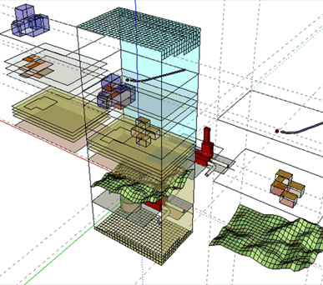
Spatial Data Model
Spatial Data Model
2D/3D/4D Environment
below/on/above the geo-surface
Geo-Spatial Entities
physical, temporal, conceptual
relational, complex
Geo-Spatial Features
layers, surfaces, fields, meshes
events, agents
3D Concept Diagram

Slide 33
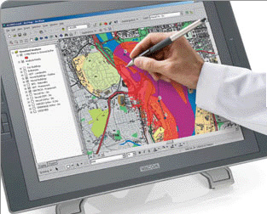
Creation Tools
Creation Tools
Drawing / Sketching
quick, intuitive, comprehensive
Modification Tools
context, content, relationships
Feature Templates
definition, representation
Inference Engines
generic, domain specific
Graphics Tablet by Wacom

Slide 34
Geoprocessing Tools
Geoprocessing Tools
Data Processing
source data, derived data
Condition Assessment
suitability, sensitivity, capacity, etc.
Evaluation Models
positive and negative impacts
Simulation Tools
time-based data, system behavior
ILARIS Model by Jones and Jones

Slide 35
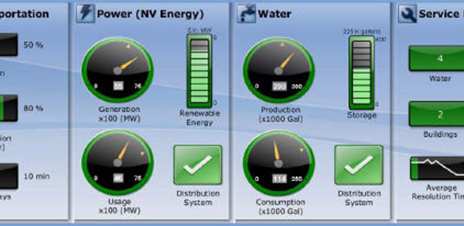
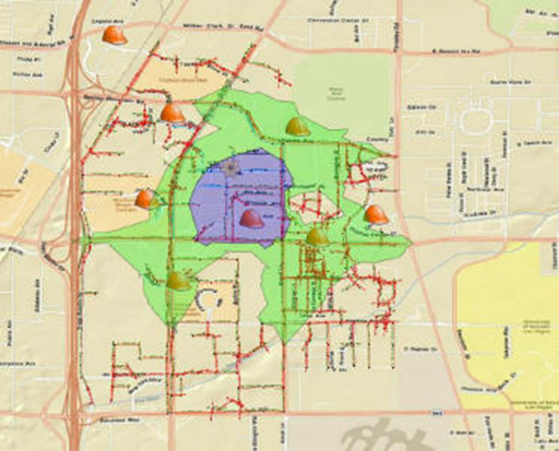
Feedback Tools
Feedback Tools
Status Fields
static, interactive
Dashboards
static, interactive
Reports
static, interactive
Internet Enabled
browser-based
Las Vegas decision support dashboard (IBM)

Slide 36
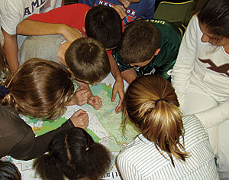
Collaboration Tools
Collaboration Tools
Virtual Studios
creation, evaluation, sharing
Project Teams
distributed in time and space
Stakeholders
alternate value sets, changing
Group-based Decisions
Delphi process, conflict resolution
K-12 Students

Slide 37
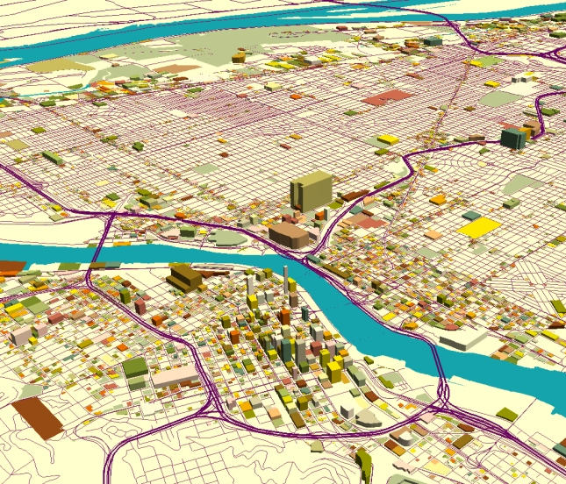
Visualization Tools
Visualization Tools
Graphics
charts, graphs, diagrams
Maps
2D, 2.5D
Scenes
3D
Movies
4D
Layouts
posters, reports
Portland by Mei-Po Kwan

Slide 38
Scenario Management Tools
Scenario Mgmt Tools
Version Control
alternate solutions, variations
Selection
evaluation, side-by-side comparison
Extraction
segments, portions, subsets
Synthesis
combine, further develop
Commercial 1
Commercial 2
E2 + C1 + R1
E1 + C2 + R2
E2 + C1 + R2
E1 + C2 + R4
E3 + C1 + R1
E2 + C2 + R2

Slide 39
GeoDesign – The Challenge

Slide 40
Title
Challenge #1
Develop a comprehensive understanding
of geodesign and then work together to translate that
understanding into a shared vision.
definition and scope of geodesign
the nature of design
the technology of geodesign
what it means to be a designer (geo-designer)

Slide 41
Title
Challenge #2
Develop an appropriate “design centric” GIS technology.
Easy to understand
Easy to use
Condition assessment tools
Rapid creation and modification of entities
On-the-fly assessment
Dashboard authoring tools
Scenario management tools
Collaboration environment

Slide 42
Title
Challenge #3
Apply that technology to a wide variety of
geo-spatial design problems.
Agriculture
Conservation
Defense
Education
Engineering
Facilities Management
Federal Government
Financial Services
Forestry
Health Care
Human Services
Mining
Petroleum
Planning
Public Safety
State & Local Gov
Surveying
Telecommunications
Transportation
Utilities
Water Resources

Slide 43
Title
Challenge #4
Work together to establish a discipline of geodesign,
both in practice and academia.
Geographic and Environmental Sciences
Landscape Architecture
Urban and Regional Planning
Architecture and Engineering
Operations Research
Computer Science
GIS

Slide 44
Thank you
“The best way to predict the future is to create it.”
… Buckminster Fuller
Bill Miller
bill.miller@.com

